Slide 1
From Zero to Hero
A Hands-On Approach to R Stats
Pierre Lafortune
pierre.a.lafortune@gmail.com

Slide 2
Agenda
R Introduction
Common Use cases
Problem Statement
Live Coding
Participant Challenges

Slide 3
R Quick Launch
Statistical software environment
Built on S programming language
Named R after originators Robert Gentleman and Ross Ihaka
Created in 1993
Open-source under General Public License
Source-code written in C, Fortran, and R
Over 6,000 packages added by contributors

Slide 4
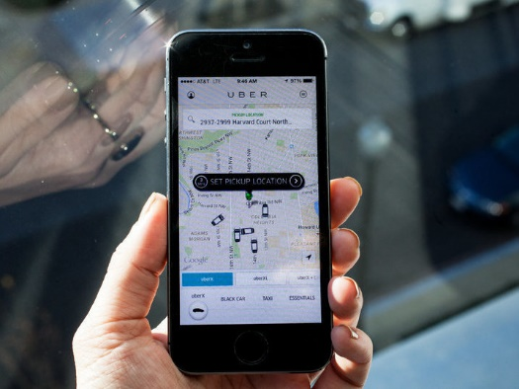

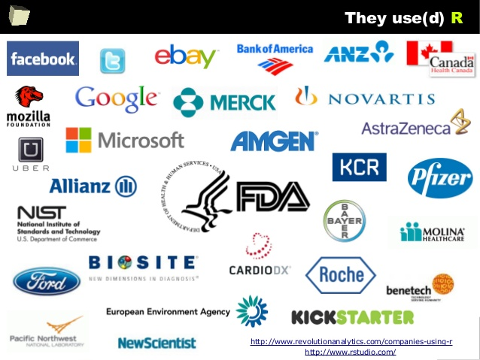


Slide 5
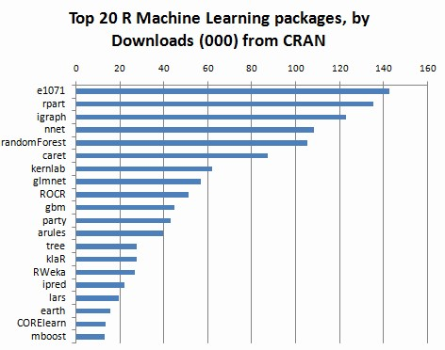

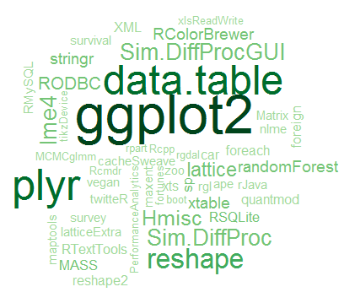
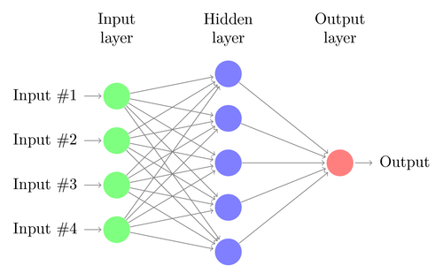

Slide 6
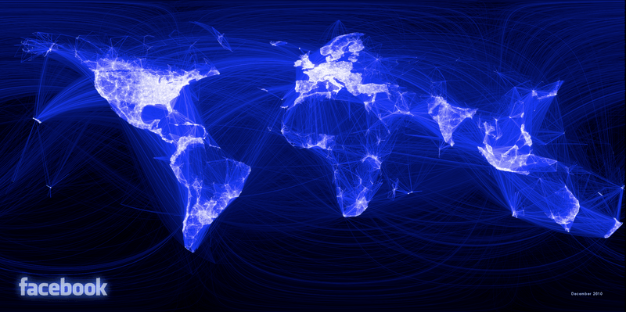
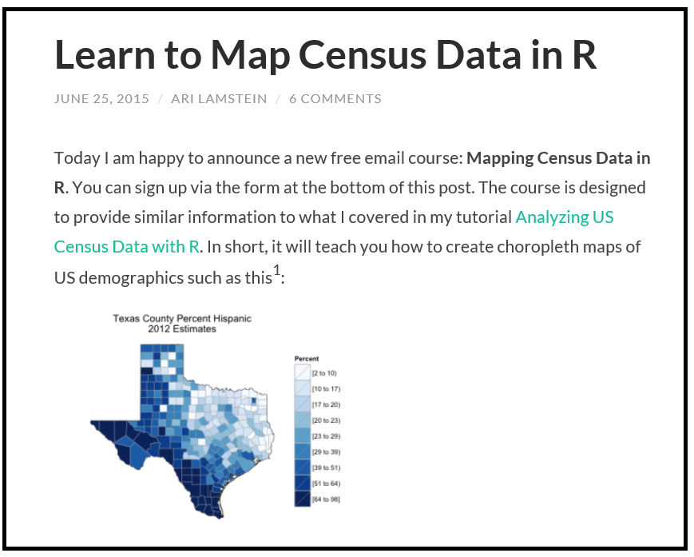
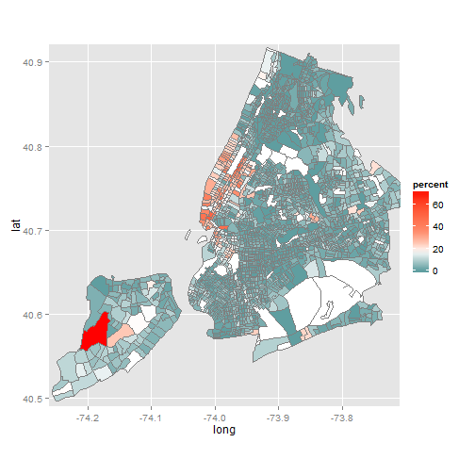
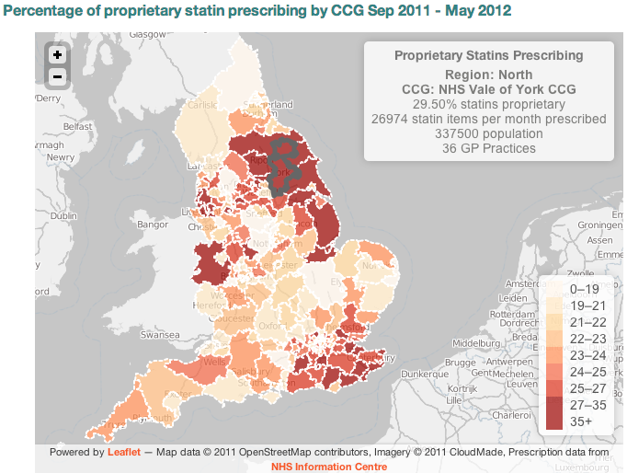

Slide 7


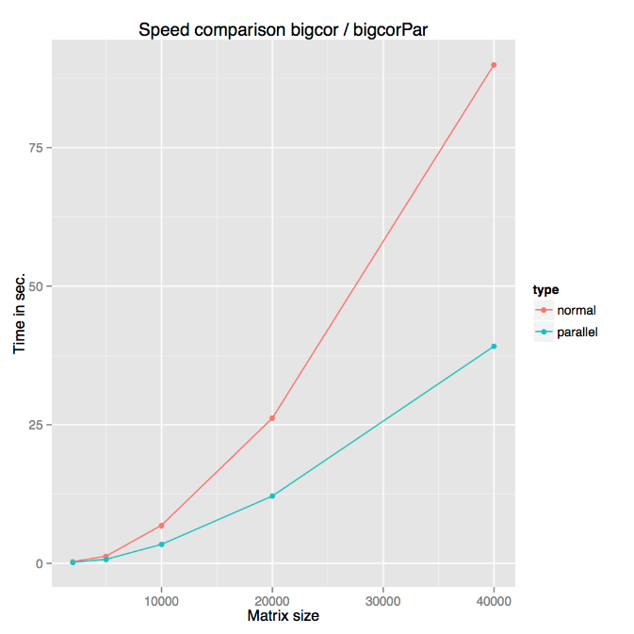
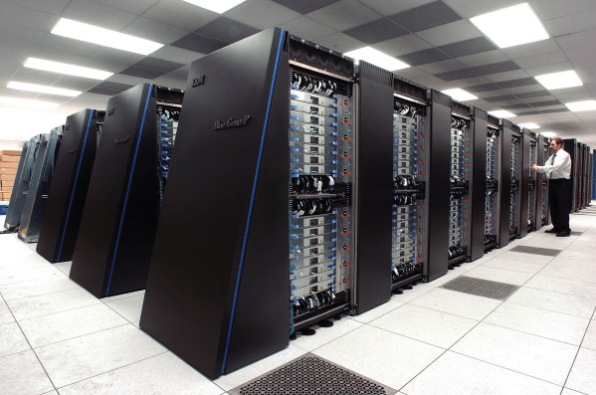
Parallel Processing

Slide 8
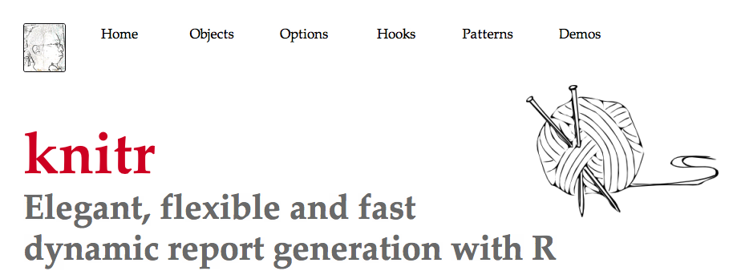

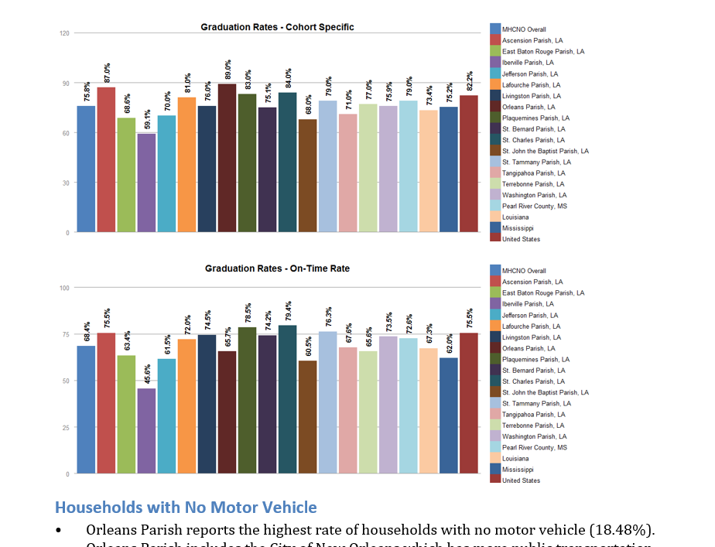
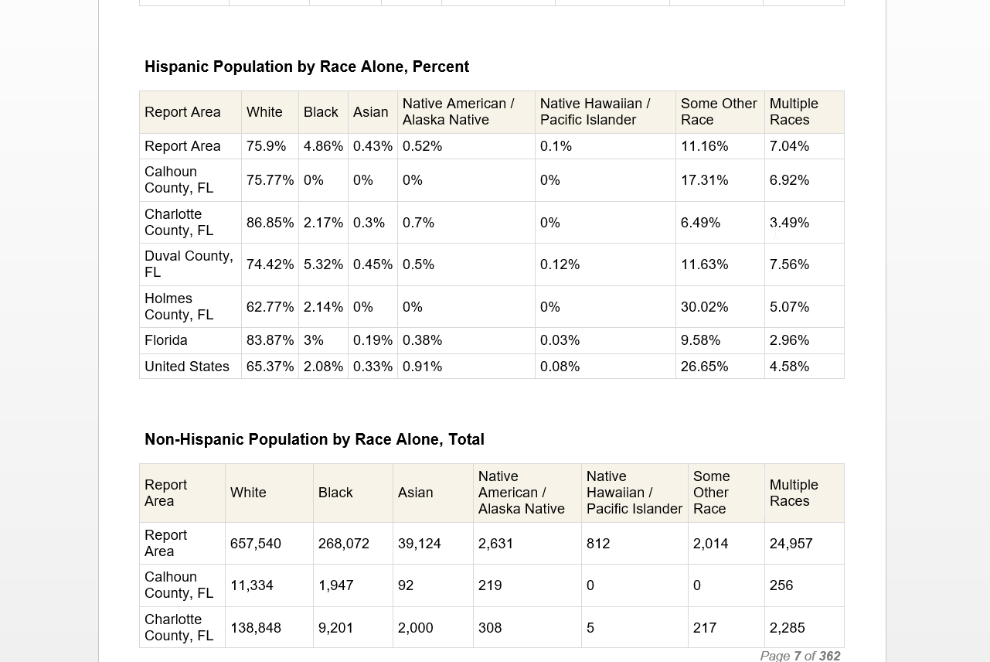

Slide 9
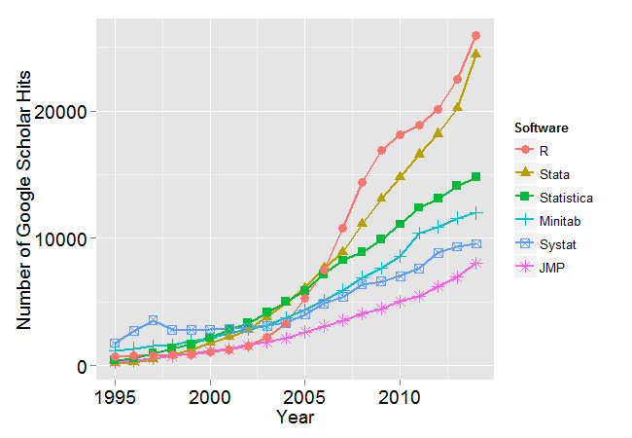
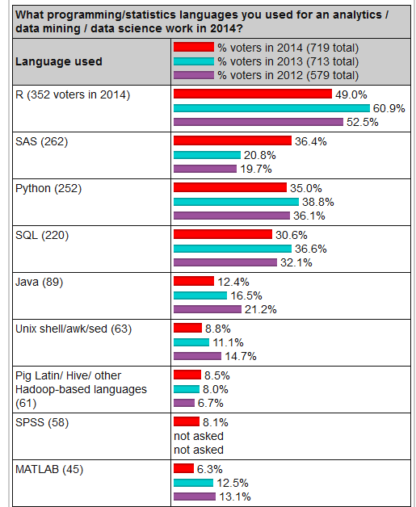
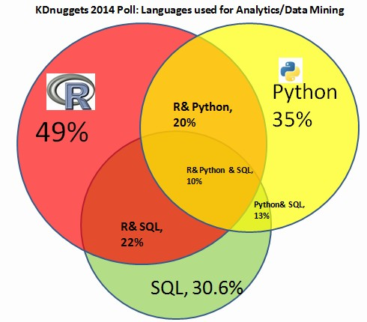
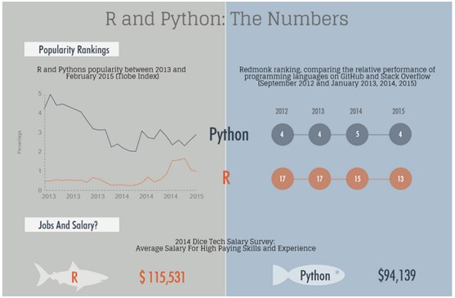

Slide 10



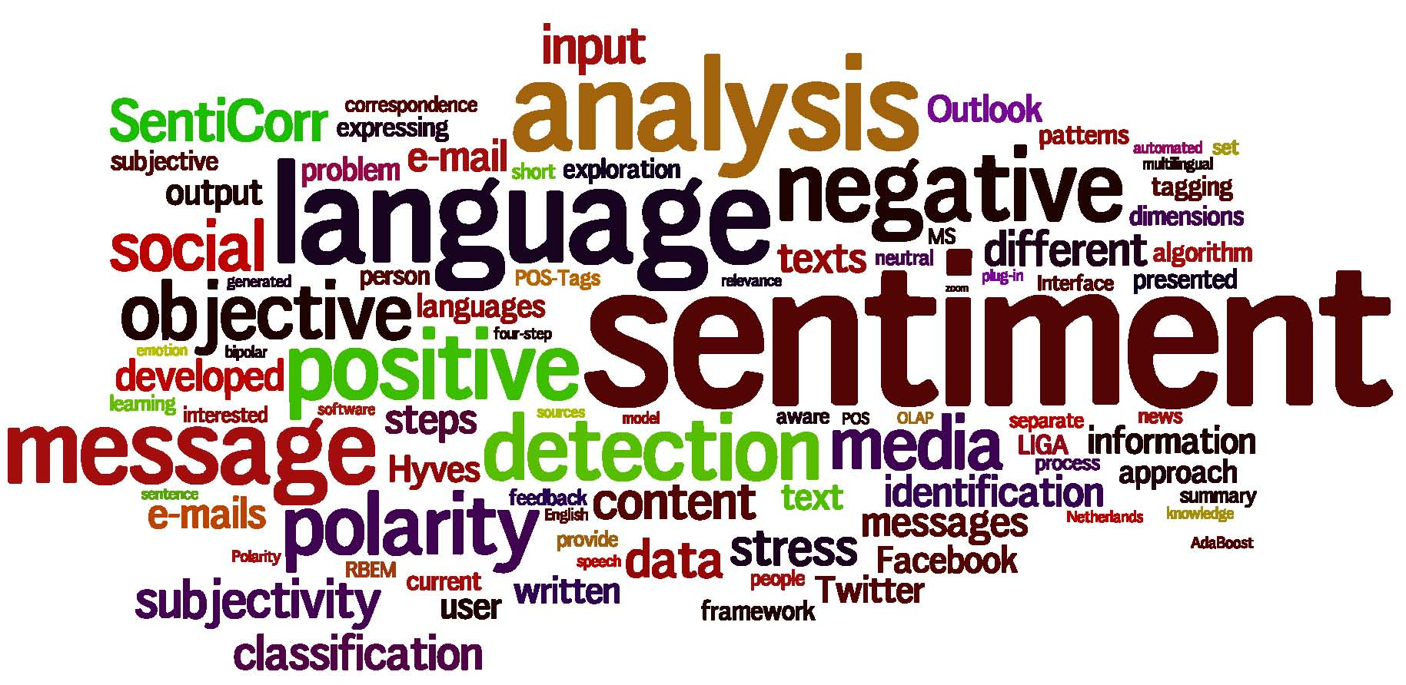


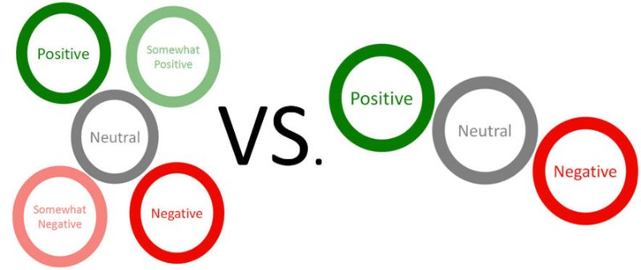
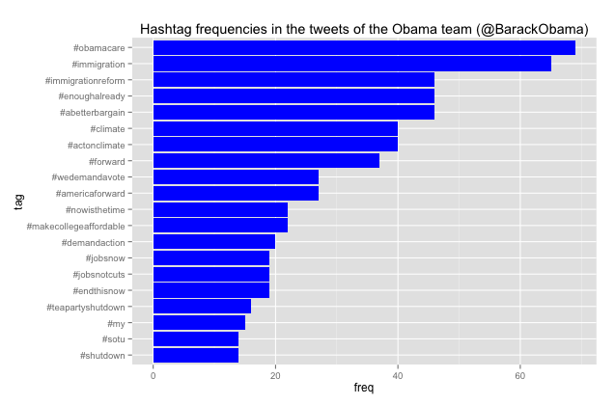

Slide 11

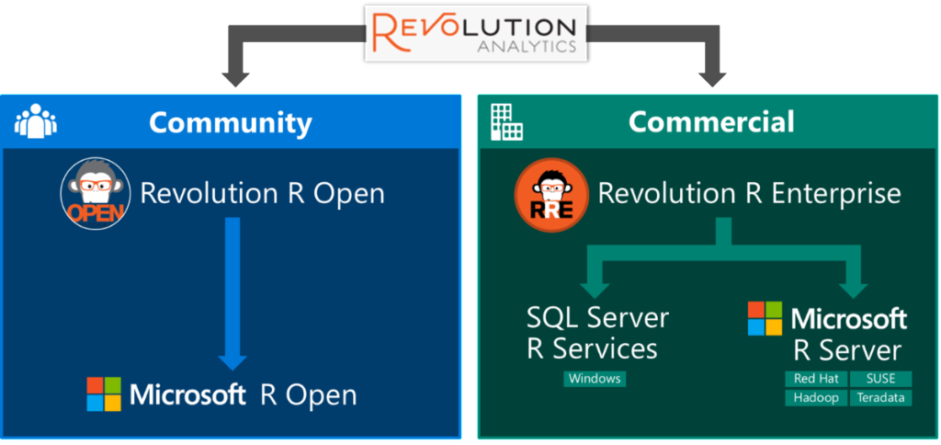
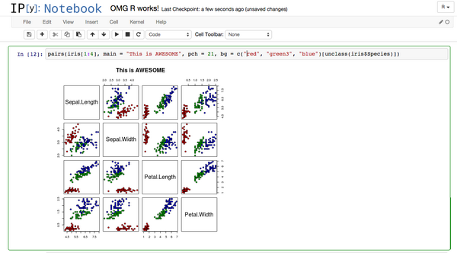



Slide 12

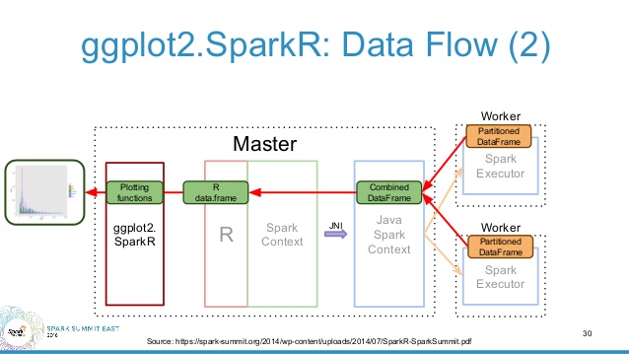


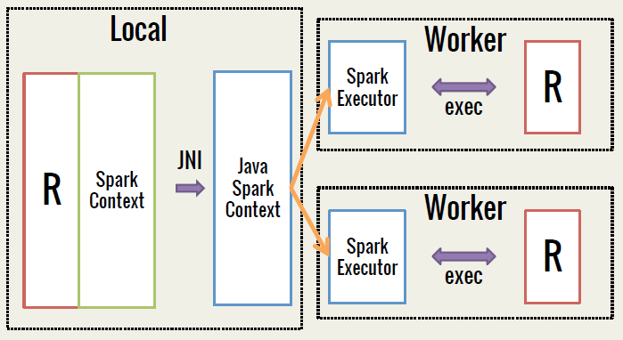
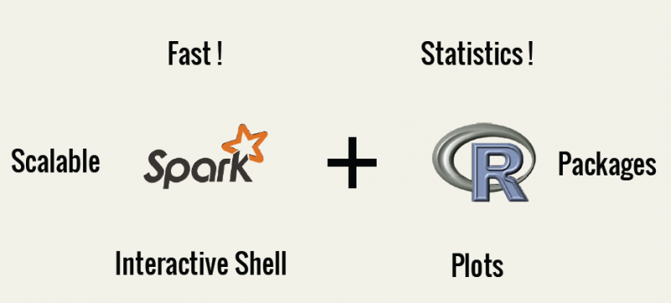

Slide 13
Congratulations!
You are the newest data scientist at Tesla Motors
First task: Fuse two data sets
Skills Required:
Data cleansing, Missing Value imputation, Classification Modeling, Clustering, Regression Analysis, Data Manipulation

Slide 14

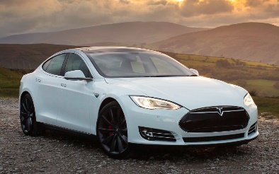
Dataset Link
Dataset B: USA Consumer Database
Dataset A: Tesla Customers
That's easy. Use a common id!
What if no common link exists?

Slide 15
Link Details
Dataset A
ID | Gender M | Gender F | Indivd_Age | Income | Environmentalist
1043 | "" | female | 34 | 9 | 1
5021 | MALE | "" | 72 | 12 | 1
4863 | "" | FEMALE | 81 | 6.5 | 1
4651 | male | "" | NA | 3.2 | 0
1002 | 99 | 99 | 49 | 21 | 0
7523 | Male | "" | 21 | -7.9 | 0
Dataset B
Age | Gender | Income | Environmentalist
28 | M | 90 | Yes
35 | F | 81 | No
14 | F | 65 | No
65 | M | 42 | Yes
44 | M | 110 | No
39 | M | 49 | No

Slide 16
Learn More
R Cookbook - Many helpful examples and topics. The “Graphs” section helps tremendously with ggplot2 http://www.cookbook-r.com/
Concise Guide to R – Covers all major R functionality http://www.cis.upenn.edu/~matuszek/Concise%20Guides/Concise%20R.html
Stack Overflow – The best help is available when you post a question here. http://stackoverflow.com/questions/tagged/r
Cross Validated – For statistics and modeling help. http://stats.stackexchange.com/
Introduction to Statistical Learning – The BEST way to learn statistics and machine learning. And it’s free!
Book: http://www-bcf.usc.edu/~gareth/ISL/
Video Lectures: http://www.r-bloggers.com/in-depth-introduction-to-machine-learning-in-15-hours-of-expert-videos/

